Slide 1

The Impact of COVID-19 on Tourism in Canada
David Boucaud
Gaya Kathiresu
Nader Saad
Ethelbert Tang

Slide 2
Why Tourism?
Tourism not only supports economic pillars but it also influences it. Restricting mobility was identified early on as a course of action to dampen the rapid spread of COVID-19, therefore tourism took an abrupt and critical blow right at the start. Tracking and tracing mobility patterns was critical in identifying infection hot spots, and determining break out clusters.
The average person can understand that there is an impact, but do we understand the depth or magnitude of this impact, on present day and looking forward?
How soon will the world travel again, and when it does, how will it travel? Will consumers’ pre-pandemic travel habits return, or will a new normal in consumer travel behavior emerge?
We will attempt to travel through a few aspects of this global downturn in tourism and highlight the role of COVID 19 in reshaping the Canadian economy.

Slide 3
Tourism and the Economy in Canada
The health of the economy is measured by Gross Domestic Product (GDP)
“The tourism industry includes transportation, accommodation and food services, travel arrangement and reservation services, and recreation and entertainment (Statistics Canada 2017).”
https://www150.statcan.gc.ca/n1/pub/11-626-x/11-626-x2020023-eng.htm

Slide 4
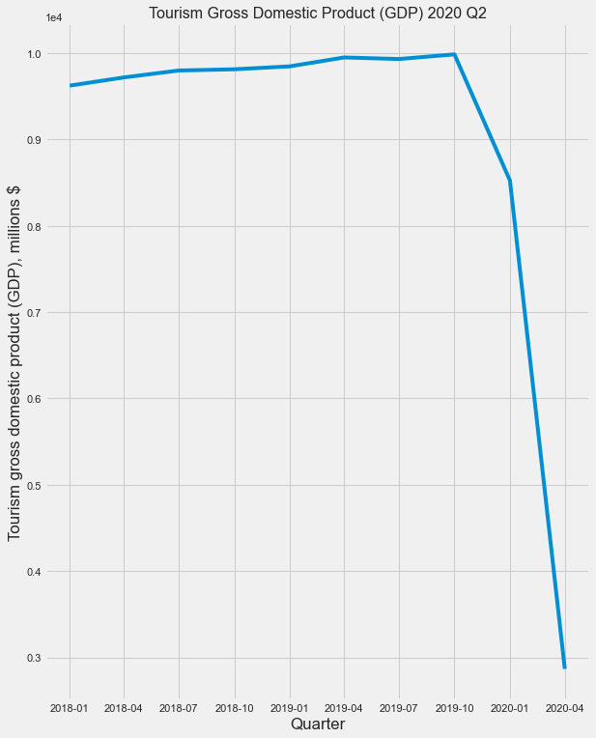
Tourism GDP dropped 66.37 %
from Q1 to Q2 in 2020
Dataset: https://doi.org/10.25318/3610023401-eng

Slide 5
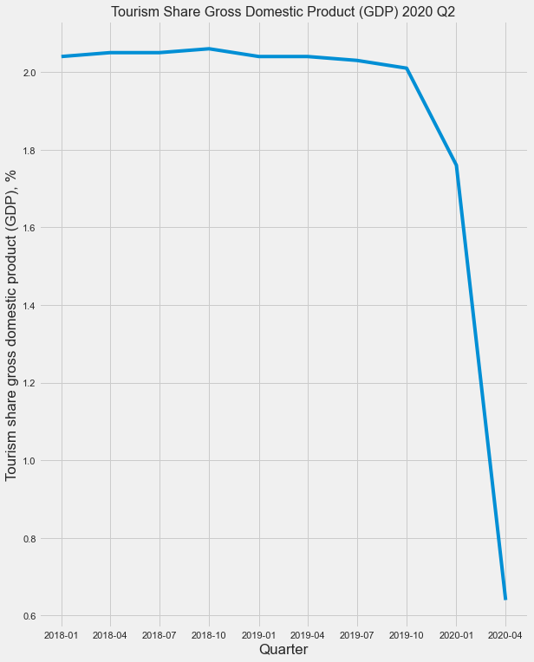
Tourism’s share of GDP
dropped 1.12 points
from Q1 to Q2 in 2020
PERIOD | PERCENT SHARE
2018-01-01 | 2.04
2018-04-01 | 2.05
2018-07-01 | 2.05
2018-10-01 | 2.06
2019-01-01 | 2.04
2019-04-01 | 2.04
2019-07-01 | 2.03
2019-10-01 | 2.01
2020-01-01 | 1.76
2020-04-01 | 0.64
Dataset: https://doi.org/10.25318/3610023501-eng

Slide 6
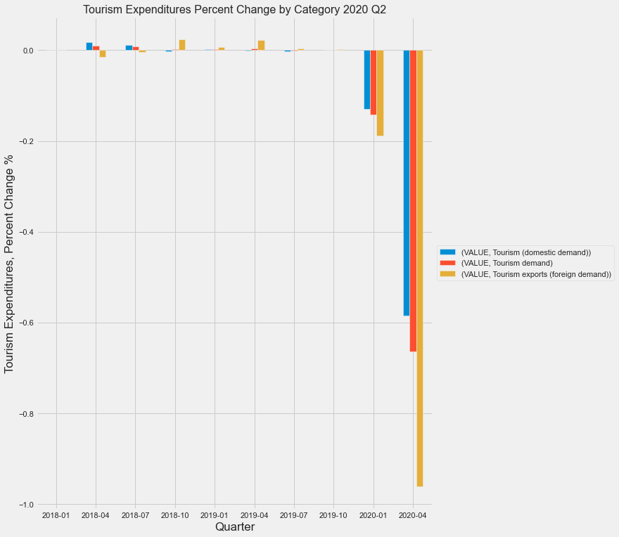
2020 Q2 saw Domestic Spending down 58.6 % and Non-resident spending down 96.2 %
Dataset: https://doi.org/10.25318/3610023001-eng

Slide 7
Recovery?
“Tourism activities will take a longer time to recover because tourism is more a luxury consumption than a basic need. It is one of the first things that people can easily delete from, and one of the last things that people will add to, their spending plan.”
https://yukon.ca/sites/yukon.ca/files/covid-19_impact_yukon_tourism.pdf

Slide 8
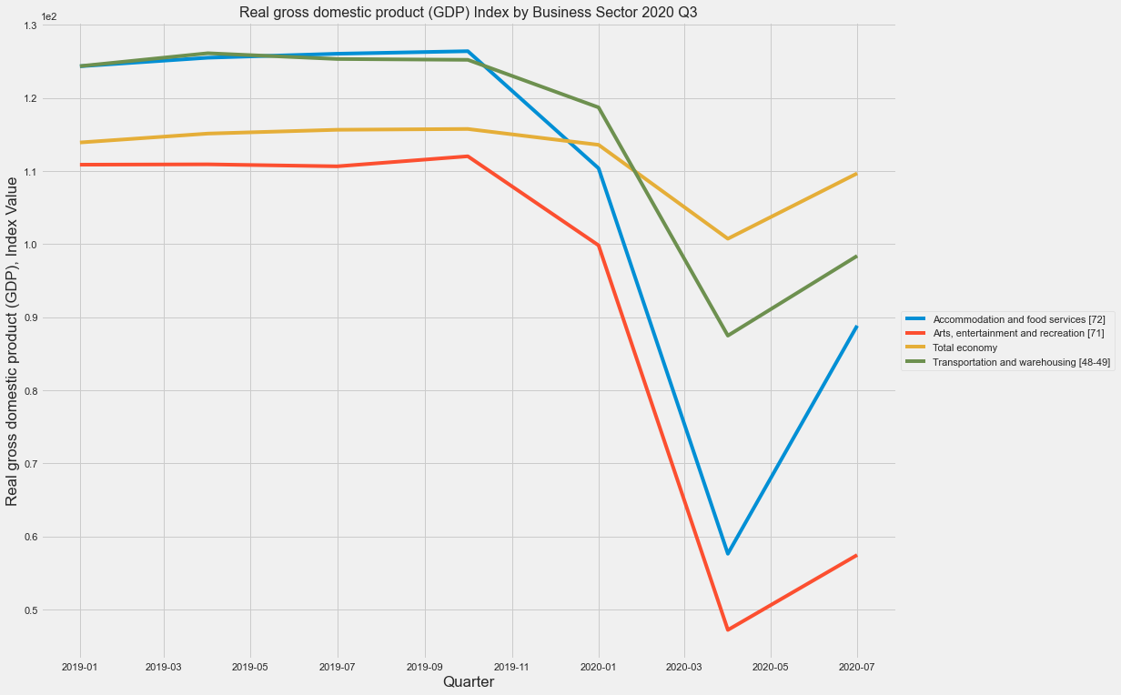
“In the third quarter, easing of the restrictions implemented to contain the pandemic led to a significant rebound in hours worked and business output, both of which saw record gains.”
https://www150.statcan.gc.ca/n1/daily-quotidien/201202/dq201202c-eng.htm
Dataset: https://doi.org/10.25318/3610020701-eng

Slide 9
Tourism and Employment

Slide 10
Tourism and Employment in Canada
The Tourism Industry plays an important role as an employer in Canada for several reasons:
Tourism has proven to be an effective alternative to resourced-based industries in rural communities (Koster and Lemelin 2009).
The majority of those employed in the tourism industry are underrepresented in the national labour force:
 | Canadian Labour Force | Tourism Sector
Workers without any certificate, diploma, or degree | 10.1% | 17.2%
Workers without a high school diploma | 25.3% | 36.6%
Immigrant workers | 23.8% | 26.0%
Non-permanent resident workers | 1.4% | 2.6%
(Tourism HR Canada 2016)

Slide 11
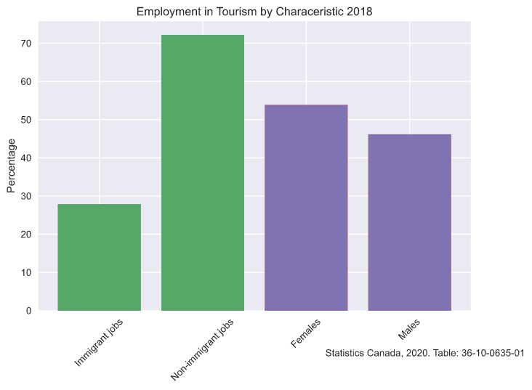
Intersectionality in Employment
Chi-Squared Test
H0: There is no significant difference between the labour characteristics of the tourism sector and that of the national workforce.
HA: There is a significant difference between the labour characteristics of the tourism sector and that of the national workforce.
Gender:
p-value: 0.0002620416431927413
Immigration Status:
p-value: 0.006786564652073491

Slide 12
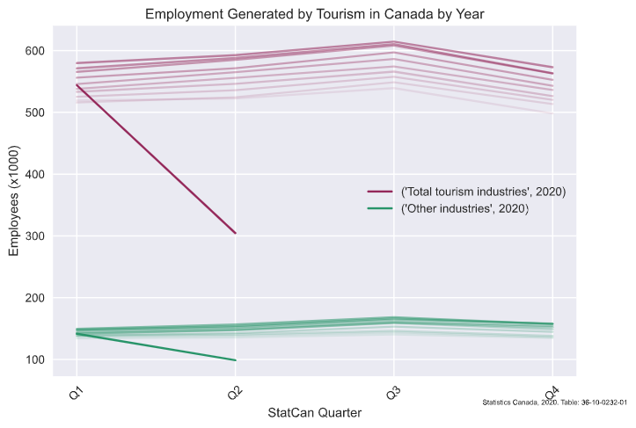
Covid-19 and Employment: An Overview
353,600 less jobs in the Tourism Sector between 2019 and 2020 Q2.

Slide 13
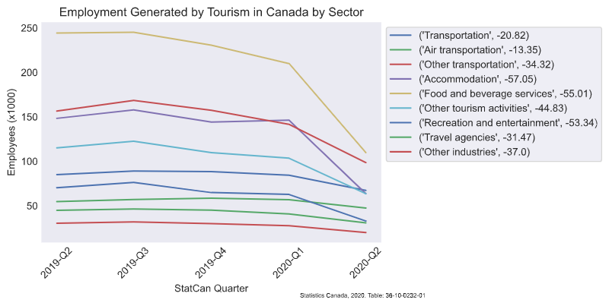
Employment by Sector

Slide 14
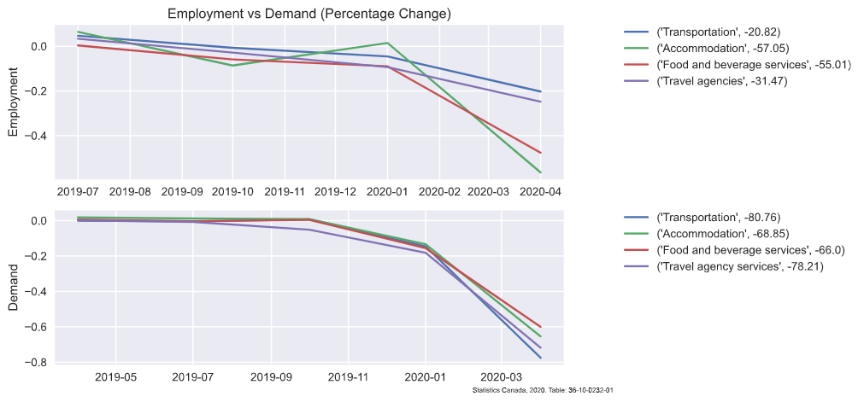
A Closer Look

Slide 15
Tourism and Travel

Slide 16
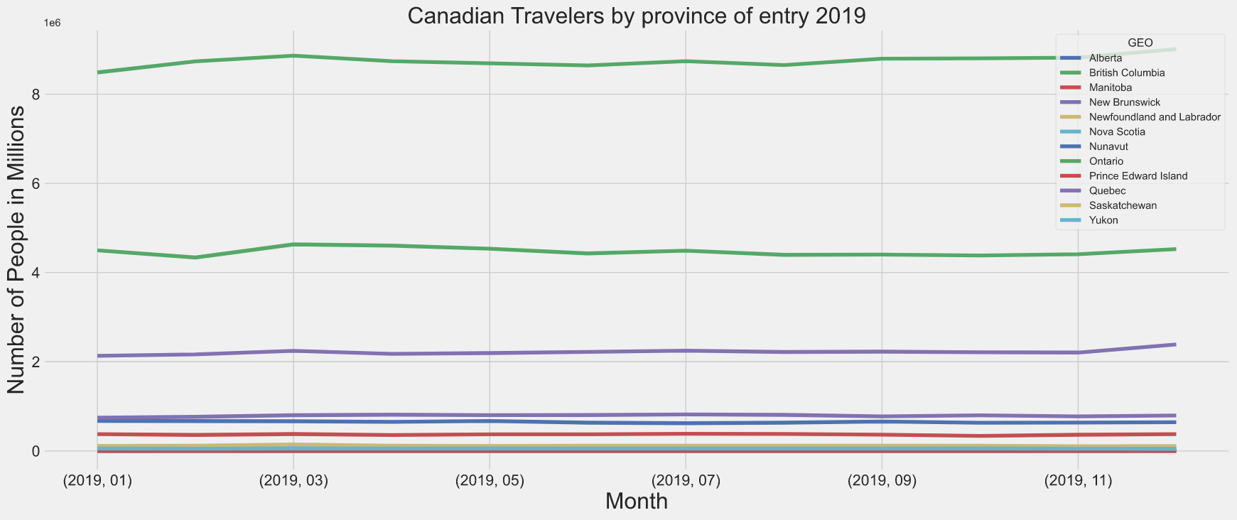

Slide 17
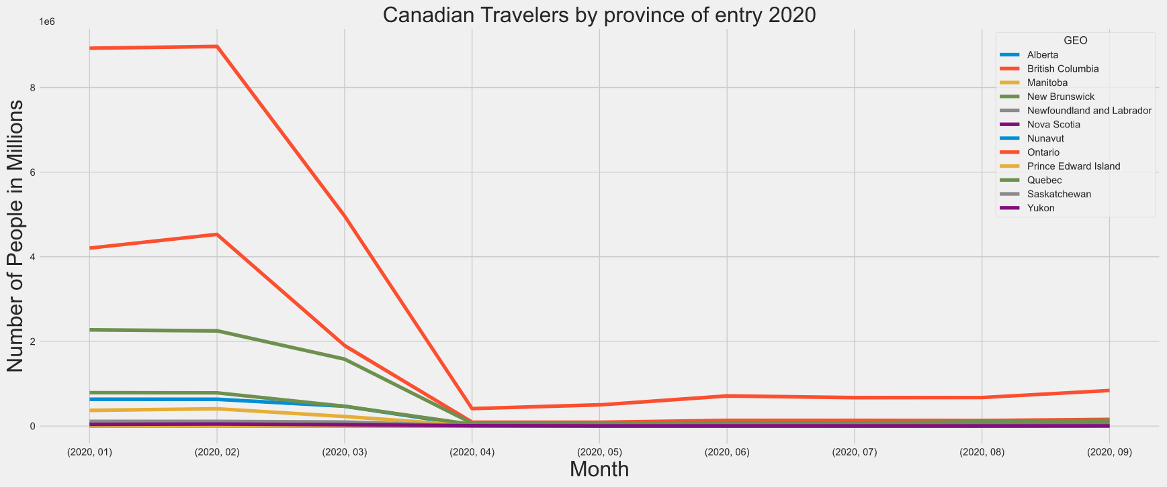

Slide 18
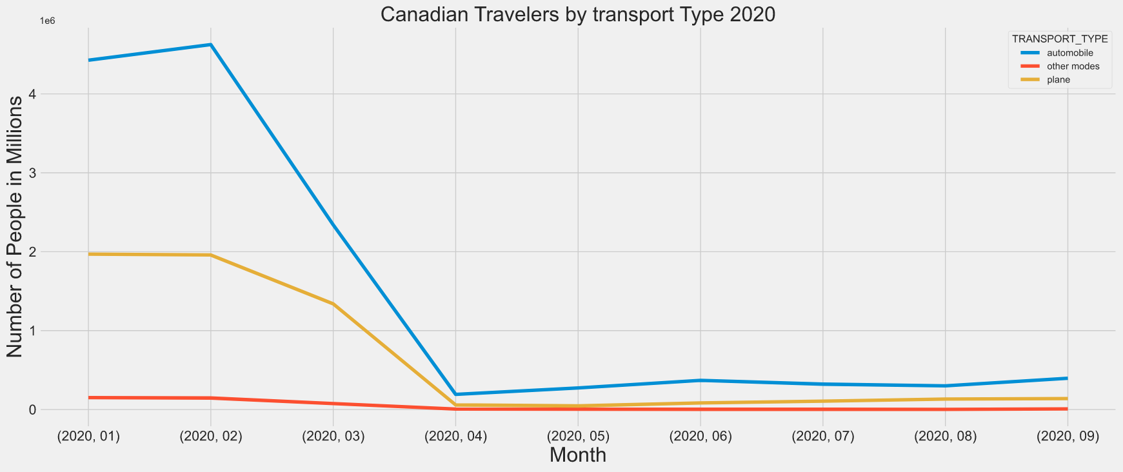

Slide 19
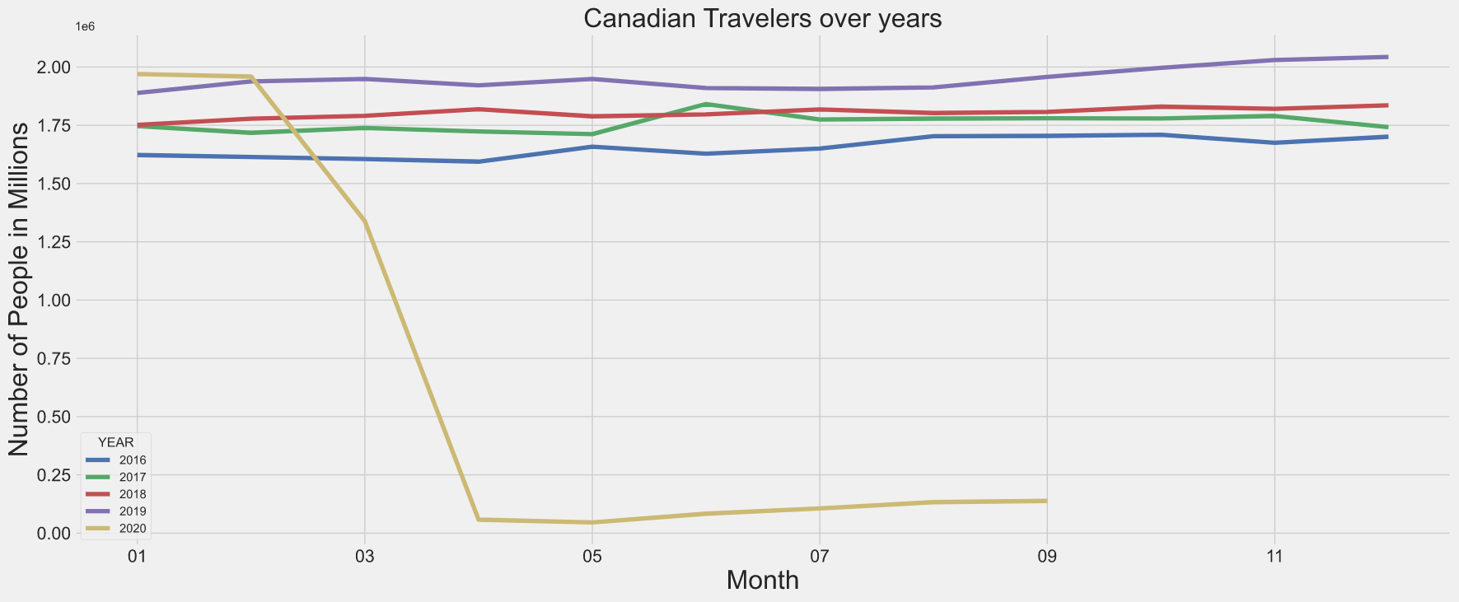

Slide 20
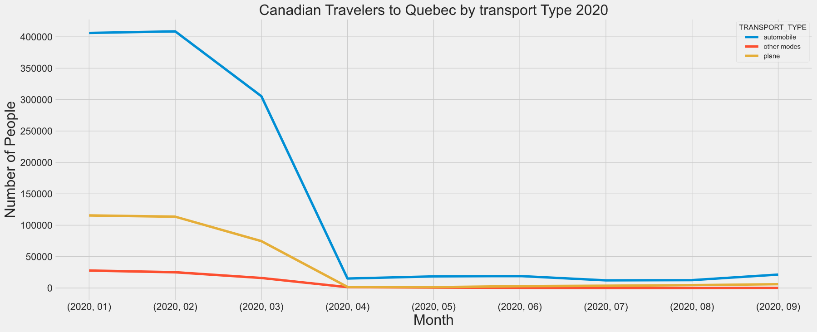

Slide 21
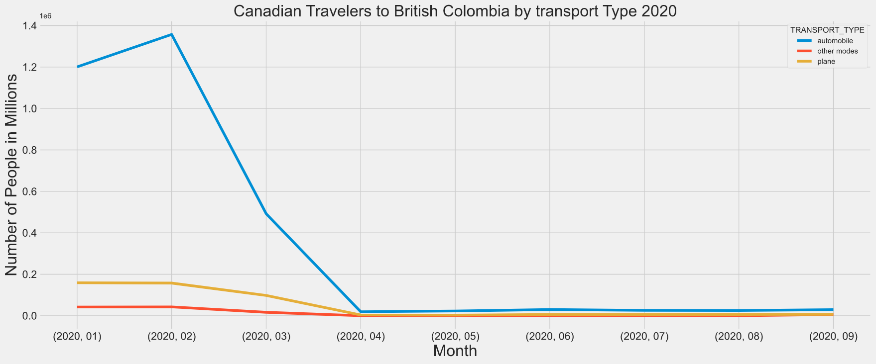

Slide 22
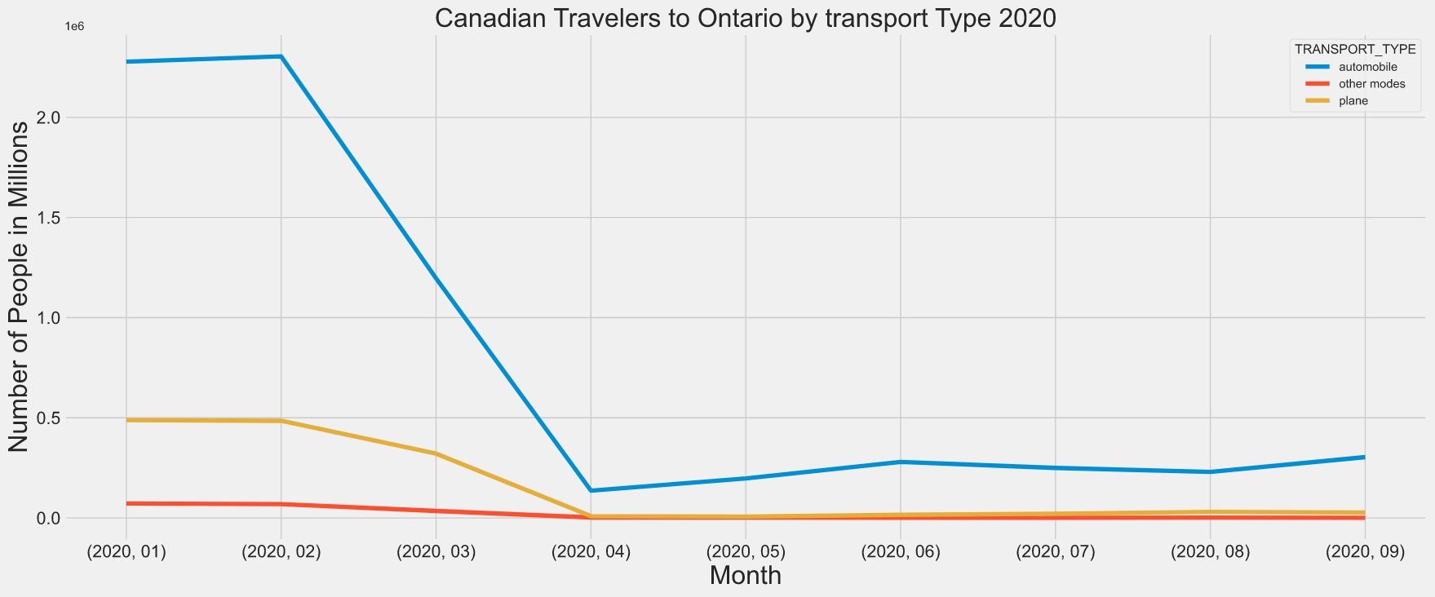

Slide 23
Tourism and Mobility

Slide 24
Literature Review: Do COVID-19 Policies Affect Mobility Behaviour? Evidence from 75 Canadian and American Cities

Slide 25
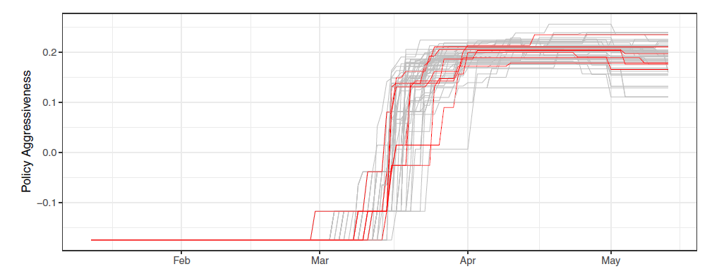
Comparison of Policies and Responses by Canadian and USA cities
Figure 1 : COVID-19 Policy Response by City
https://www.utpjournals.press/doi/pdf/10.3138/cpp.2020-062

Slide 26
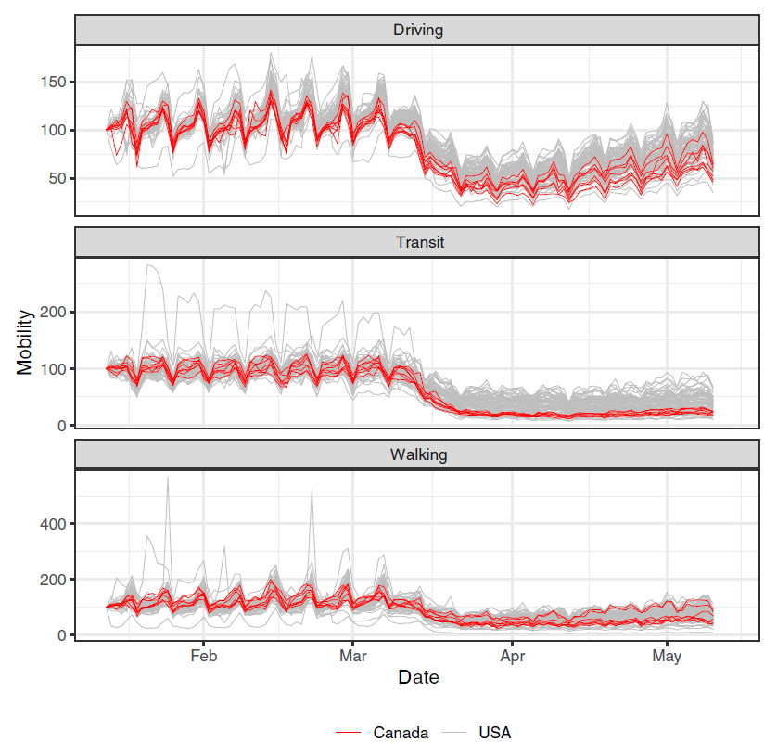
The efficacy of the responses
Figure 2 : Mobility by City
https://www.utpjournals.press/doi/pdf/10.3138/cpp.2020-062

Slide 27
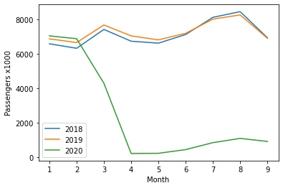
Canadian Airline Passenger Numbers Compared
Initially steady increase in January 2020 and February 2020
Sudden drop due to COVID-19 restrictions in place in March
Progression towards recovery in the 3rd quarter.
Month | Percentage Change from 2019
January | 2.53%
February | 3.33%
March | -44.07%
April | -96.98%
May | -96.72%
June | -93.89%
July | -89.47%
August | -86.82%
September | -86.78%
Dataset: https://www150.statcan.gc.ca/t1/tbl1/en/cv.action?pid=2310007901

Slide 28
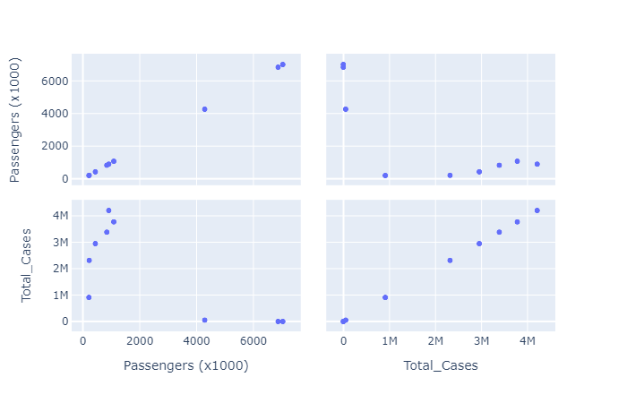
Scatter-Matrix between total number of COVID-19 cases and Airline Passengers
Datasets: https://www150.statcan.gc.ca/t1/tbl1/en/cv.action?pid=2310007901
https://resources-covid19canada.hub.arcgis.com/datasets/PHAC-ASPC::covid19-data/data

Slide 29
References
Armstrong, D., Lebo, M. and Lucas, J., 2020. Do COVID-19 Policies Affect Mobility Behaviour? Evidence from 75 Canadian and American Cities. Canadian Public Policy, [online] 46(S2), pp.S127-S144. Available at: <https://www.utpjournals.press/doi/pdf/10.3138/cpp.2020-062>.
Brodeur, A., Gray, D., Islam, A. and Bhuiyan, S., 2020. A Literature Review Of The Economics Of COVID-19. [online] https://www.econstor.eu/. Available at: <https://www.econstor.eu/bitstream/10419/222316/1/GLO-DP-0601.pdf> [Accessed 22 December 2020].
https://tiac-aitc.ca/. 2020. STATE OF TOURISM IN CANADA DURING COVID-19. [online] Available at: <https://tiac-aitc.ca/_Library/Coronavirus_2020/TIAC_14472_State_of_Tourism_in_Canada_during_COVID-19_Dashboard_EN.pdf> [Accessed 22 December 2020].
Koster, R. and Lemelin, R., 2009. Appreciative Inquiry and Rural Tourism: A Case Study from Canada. Tourism Geographies, [online] 11(2), pp.256-269. Available at: <https://www.tandfonline.com/doi/abs/10.1080/14616680902827209> [Accessed 22 December 2020].
Resources-covid19canada.hub.arcgis.com. 2020. COVID19 Data. [online] Available at: <https://resources-covid19canada.hub.arcgis.com/datasets/PHAC-ASPC::covid19-data/data> [Accessed 22 December 2020].
Tourism Economics. 2020. COVID-19’S Impact On Canada’S Tourism Industry - Tourism Economics. [online] Available at: <https://www.tourismeconomics.com/case-studies/covid-19s-impact-on-canadas-tourism-industry/> [Accessed 22 December 2020].
Tourismhr.ca. 2016. Profile Of Canada’S Tourism Employees. [online] Available at: <http://tourismhr.ca/wp-content/uploads/Demographic_Profile_Tourism_Sector_Employees_2016.pdf> [Accessed 22 December 2020].
Wang, W., 2020. Yukon In COVID-19 Pandemic: Decline In Tourism. [online] https://yukon.ca/. Available at: <https://yukon.ca/sites/yukon.ca/files/covid-19_impact_yukon_tourism.pdf> [Accessed 22 December 2020].
Www150.statcan.gc.ca. 2020. Employment Generated By Tourism (X 1,000). [online] Available at: <https://www150.statcan.gc.ca/t1/tbl1/en/tv.action?pid=3610023201> [Accessed 22 December 2020].
Www150.statcan.gc.ca. 2020. Indexes Of Labour Productivity And Related Measures, By Business Sector Industry, Seasonally Adjusted. [online] Available at: <https://www150.statcan.gc.ca/t1/tbl1/en/tv.action?pid=3610020701> [Accessed 22 December 2020].

Slide 30
References
Www150.statcan.gc.ca. 2020. International Travellers Entering Or Returning To Canada, By Province Of Entry, Seasonally Adjusted. [online] Available at: <https://www150.statcan.gc.ca/t1/tbl1/en/cv!recreate.action?pid=2410000501&selectedNodeIds=&checkedLevels=0D1,0D2,1D1,1D2,1D3,1D4&refPeriods=20150901,20200901&dimensionLayouts=layout3,layout2,layout3&vectorDisplay=false> [Accessed 22 December 2020].
Www150.statcan.gc.ca. 2020. Operating And Financial Statistics For Major Canadian Airlines, Monthly. [online] Available at: <https://www150.statcan.gc.ca/t1/tbl1/en/cv.action?pid=2310007901> [Accessed 22 December 2020].
Www150.statcan.gc.ca. 2020. Tourism Demand In Canada, Constant Prices (X 1,000,000)1. [online] Available at: <https://www150.statcan.gc.ca/t1/tbl1/en/tv.action?pid=3610023001> [Accessed 22 December 2020].
Www150.statcan.gc.ca. 2020. Tourism Gross Domestic Product, Constant Prices. [online] Available at: <https://www150.statcan.gc.ca/t1/tbl1/en/tv.action?pid=3610023401> [Accessed 22 December 2020].
Www150.statcan.gc.ca. 2020. Tourism Share Of Gross Domestic Product At Basic Prices. [online] Available at: <https://www150.statcan.gc.ca/t1/tbl1/en/tv.action?pid=3610023501> [Accessed 22 December 2020].
Www150.statcan.gc.ca. 2020. Add/Remove Data - Jobs, Hours Worked And Employment Income Of Employees In Tourism Industries, By Employee Characteristics. [online] Available at: <https://www150.statcan.gc.ca/t1/tbl1/en/cv.action?pid=3610063501> [Accessed 22 December 2020].
Www150.statcan.gc.ca. 2020. Add/Remove Data - Labour Force Characteristics By Immigrant Status, Annual. [online] Available at: <https://www150.statcan.gc.ca/t1/tbl1/en/cv.action?pid=1410008301> [Accessed 22 December 2020].
Www150.statcan.gc.ca. 2020. Labour Force Characteristics By Sex And Detailed Age Group, Annual, Inactive (X 1,000). [online] Available at: <https://www150.statcan.gc.ca/t1/tbl1/en/cv.action?pid=1410001801> [Accessed 22 December 2020].

